Slide 1



한국방송미디어공학회 2022년 하계학술대회 학부생 논문 [VS2-06] 적응적 크기 조정을 이용한 블록 기반 신경망 이미지 부호화 Neural Image Compression using Block based Adaptive Resizing
2022.06.21
*박민정, 김영웅, **김동현, **임성창, 김휘용⁺
* mindyeoi@khu.ac.kr * (발표자), **(ETRI), ⁺(교신저자)
http://vmlab.khu.ac.kr

Slide 2
Contents
Introduction
Proposed Method
Experiment
Result
Conclusion

Slide 3
Introduction

Slide 4
Introduction
The importance of Image compression
According to the Cisco visual networking index, over 70% of internet traffic today is the streaming of digital media, and this percentage keeps rising over years.
Compression techniques make sharing the content quick and efficient.
Without data compression, the time and bandwidth costs for getting the information would be exorbitant.
Neural Image Compression
It has been challenging for classic compression algorithms, such as JEPG and PNG, to adapt to the growing demand.
Recently, there is an increasing interest of using machine learning (ML) based approaches to improve the compression of images and videos.
Neural image compression networks have reached or exceeded classic compression algorithm.

Slide 5
Introduction
Neural Image Compression for On-Device
While Neural image compression networks are state of the art in rate-distortion performance, using these models on a devices remains a challenge because of the limited resources of the device.
So it is essential to devise the techniques to use these networks on the device.

Slide 6
Proposed Method

Slide 7






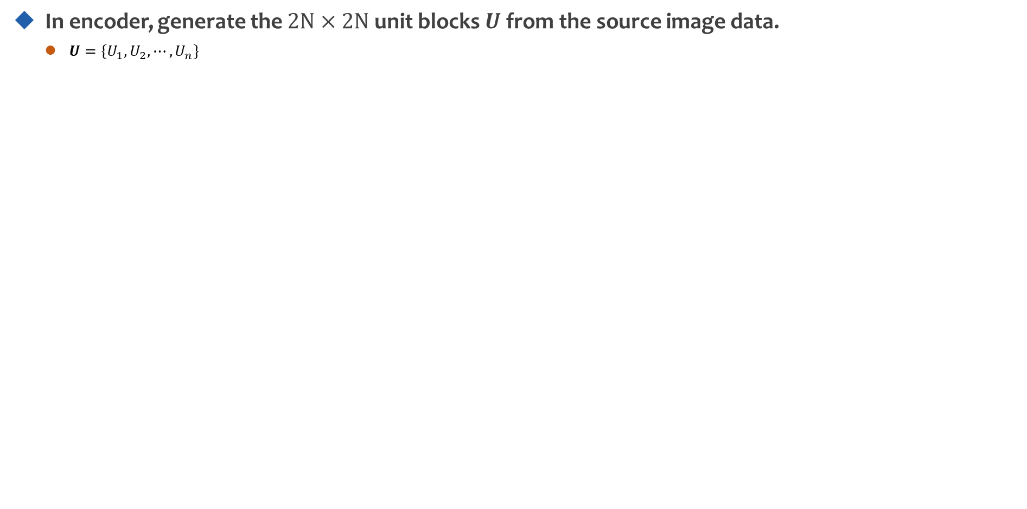





Proposed Method
In encoder, generate the $2N×2N$ unit blocks $U$ from the source image data.
$U=\{U_{1},U_{2},⋯,U_{n}\}$
$$U_{1}$$
$$U_{2}$$
$$⋯$$
$$U_{m}$$
2N
$$⋯$$
$$⋯$$
$$⋯$$
$$⋯$$
2N
$$U_{n}$$
Unit Block
Source Image Data
Fig 1. Generating $2N×2N$ unit blocks method

Slide 8
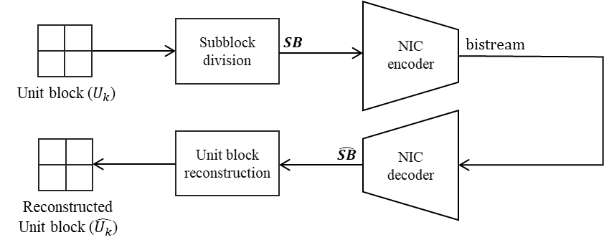
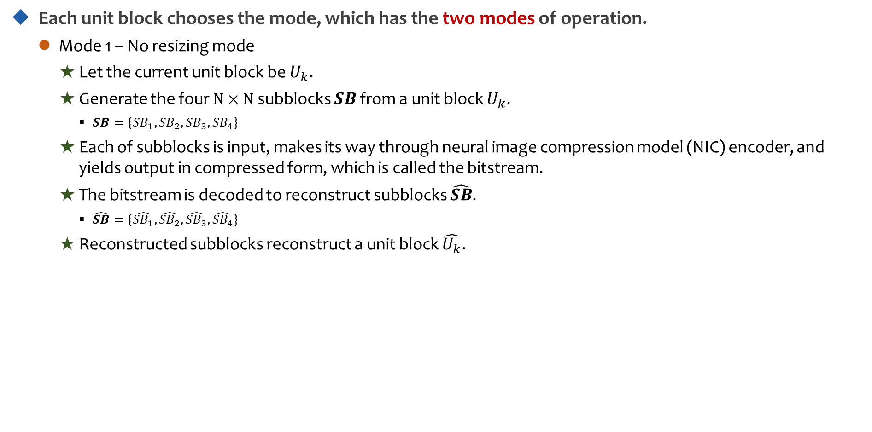
Proposed Method
Each unit block chooses the mode, which has the two modes of operation.
Mode 1 – No resizing mode
Let the current unit block be $U_{k}$.
Generate the four $N×N$ subblocks $SB$ from a unit block $U_{k}$.
$SB=\{{SB}_{1},{SB}_{2},{SB}_{3},{SB}_{4}\}$
Each of subblocks is input, makes its way through neural image compression model (NIC) encoder, and yields output in compressed form, which is called the bitstream.
The bitstream is decoded to reconstruct subblocks $\hat{SB}$.
$\hat{SB}=\{\hat{{SB}_{1}},\hat{{SB}_{2}},\hat{{SB}_{3}},\hat{{SB}_{4}}\}$
Reconstructed subblocks reconstruct a unit block $\hat{U_{k}}$.
Fig 2. Mode 1 processing steps block diagram

Slide 9
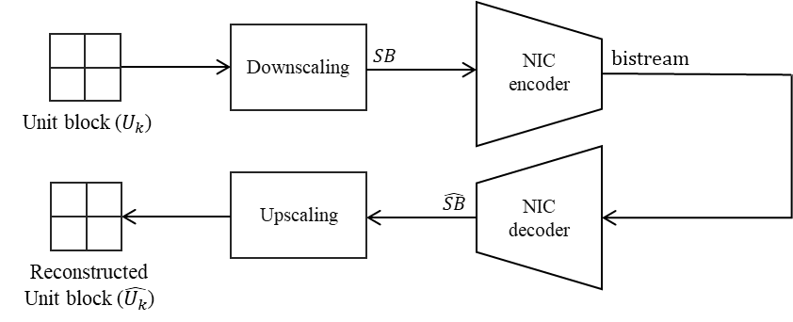
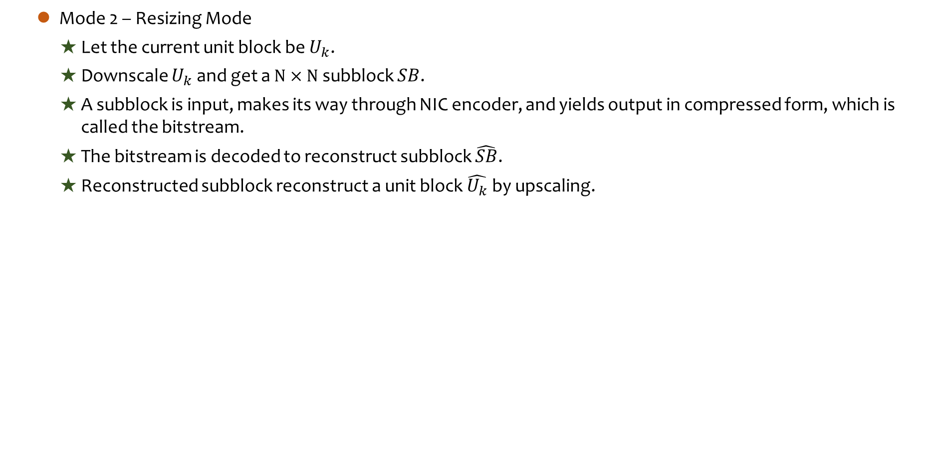
Proposed Method
Mode 2 – Resizing Mode
Let the current unit block be $U_{k}$.
Downscale $U_{k}$ and get a $N×N$ subblock $SB$.
A subblock is input, makes its way through NIC encoder, and yields output in compressed form, which is called the bitstream.
The bitstream is decoded to reconstruct subblock $\hat{SB}$.
Reconstructed subblock reconstruct a unit block $\hat{U_{k}}$ by upscaling.
Fig 3. Mode 2 processing steps block diagram

Slide 10
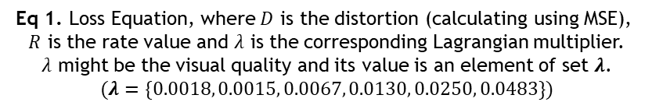
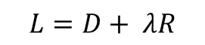
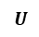
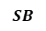
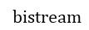
Proposed Method
Encoder decides the mode to encode which has the least loss.
Loss is defined as Rate-Distortion Cost.
$$L=D+ λR$$
Eq 1. Loss Equation, where $D$ is the distortion (calculating using MSE),
$R$ is the rate value and $λ$ is the corresponding Lagrangian multiplier.
$λ$ might be the visual quality and its value is an element of set $λ$.
$$(λ=\{0.0018, 0.0015, 0.0067, 0.0130, 0.0250, 0.0483\})$$
Unit blocks
division
$$U$$
Mode Decision
$$SB$$
NIC
encoder
$$bistream$$
Source Image Data
Fig 4. Neural image compression using block based
adaptive resizing encoder block diagram

Slide 11
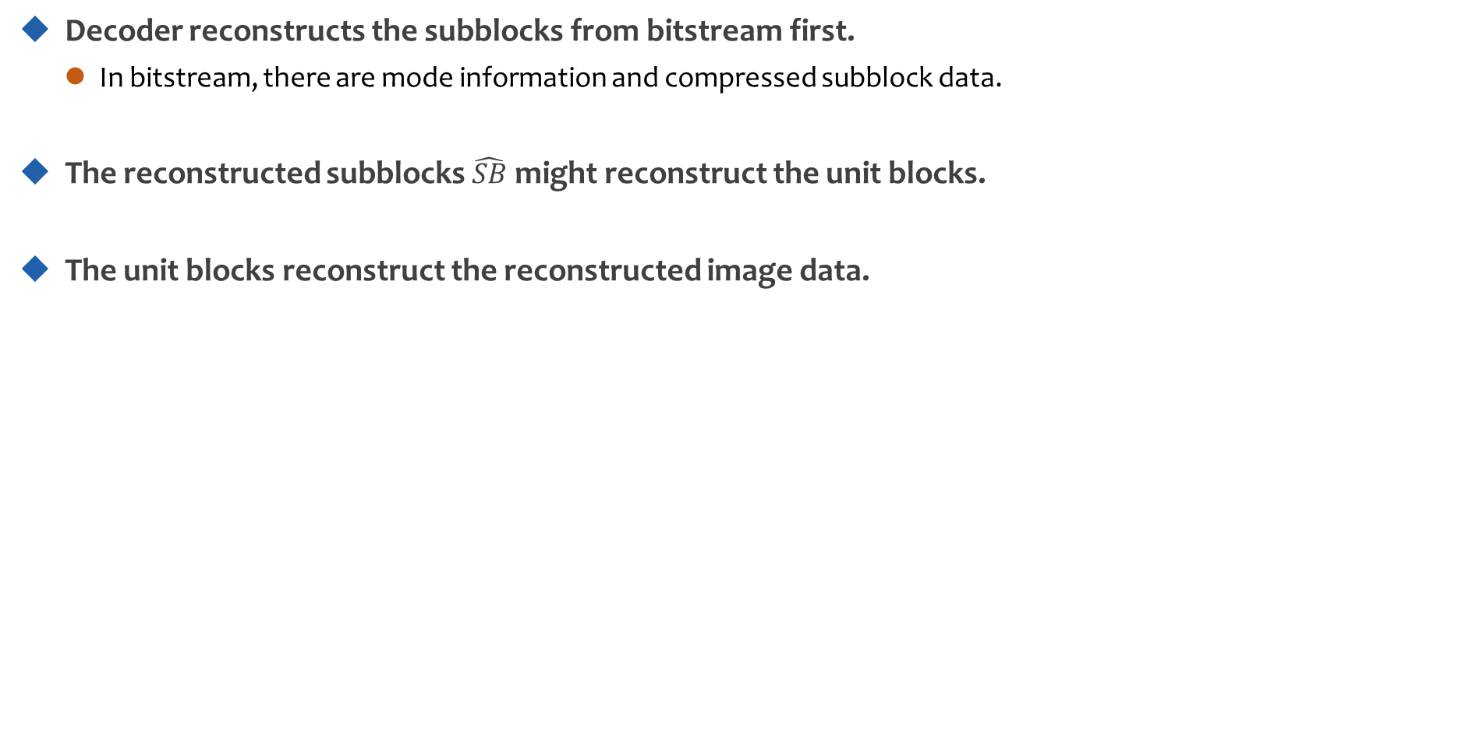
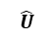
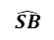
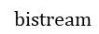
Proposed Method
Decoder reconstructs the subblocks from bitstream first.
In bitstream, there are mode information and compressed subblock data.
The reconstructed subblocks $\hat{SB}$ might reconstruct the unit blocks.
The unit blocks reconstruct the reconstructed image data.
$$bistream$$
NIC
decoder
$$\hat{SB}$$
Unit blocks
reconstruction
$$\hat{U}$$
Image data
reconstruction
Reconstructed
Image Data
Fig 5. Neural image compression using block based
adaptive resizing decoder block diagram

Slide 12
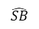
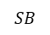
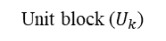
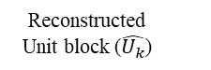
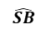
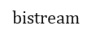
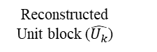
Downscaling
$$SB$$
NIC
encoder
$$bistream$$
Unit block ($U_{k}$)
Upscaling
$$\hat{SB}$$
NIC
decoder
Reconstructed
Unit block ($\hat{U_{k}}$)
Subblock division
$$SB$$
NIC
encoder
$$bistream$$
Unit block ($U_{k}$)
Unit block
reconstruction
$$\hat{SB}$$
NIC
decoder
Reconstructed
Unit block ($\hat{U_{k}}$)

Slide 13
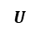
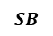
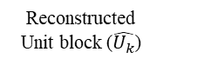
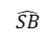
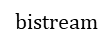
Unit blocks
division
$$U$$
Mode Decision
$$SB$$
NIC
encoder
$$bistream$$
Source Image Data
Downscaling
$$SB$$
NIC
encoder
$$bistream$$
Upscaling
$$\hat{SB}$$
NIC
decoder
Reconstructed
Unit block ($\hat{U_{k}}$)

